Slide 1
Introduction to FloPy Practical Week 8 Structure
Feedback from previous practical
Live code demo (Joseph)
Introduction to Tasks A and B - Practicals in weeks 8, 10 and 11

Slide 2
Boundary Conditions
A common misconception is that you “remove ibound because we are now working with an unconfined aquifer, which doesn't have boundaries, whereas in practical 1 we needed boundaries as we were working with a confined aquifer”.
According to the MODFLOW Manual….
IBOUND—is the boundary variable.
Defining appropriate boundary conditions is critical.

Slide 3
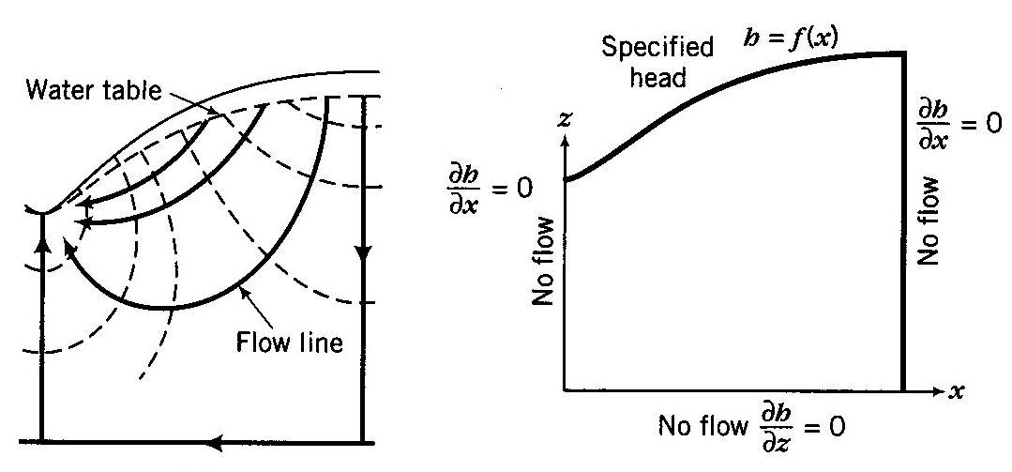
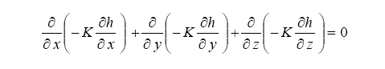
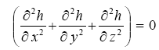
Fundamentals of Groundwater Flow Modelling
GW flow equation
Hydraulic conductivity
Gradient in hydraulic head
Assuming
homogeneous fluid properties (ρ & υ)
steady state (no change through time)
This equation tells us the relationship of head in a cell to the other cells, but how do we get the absolute values?

Slide 4
Fundamentals of Groundwater Flow Modelling
GW flow equation
Flow domain Absolute dimensions?
Discretisation?
Hydraulic conductivity
Gradient in hydraulic head
Assuming
homogeneous fluid properties (ρ & υ)
steady state (no change through time)
This equation tells us the relationship of head in a cell to the other cells, but how do we get the absolute values?

Slide 5
Fundamentals of Groundwater Flow Modelling
GW flow equation
Flow domain Absolute dimensions?
Discretisation?
Boundary Conditions - we have to know the actual value of head somewhere in the problem..
Hydraulic conductivity
Gradient in hydraulic head
Assuming
homogeneous fluid properties (ρ & υ)
steady state (no change through time)
This equation tells us the relationship of head in a cell to the other cells, but how do we get the absolute values?
Boundary conditions can be;
Known head – called Dirichlet condition eg water table
Known flux – called Neumann condition eg no flow boundary

Slide 6
Boundary Conditions
According to the MODFLOW Manual….
IBOUND—is the boundary variable.
One value is read for every model cell.
If IBOUND(J,I,K) < 0, cell J,I,K has a constant head
If IBOUND(J,I,K) = 0, cell J,I,K is inactive (fixed head)
If IBOUND(J,I,K) > 0, cell J,I,K is active (head can vary)
These values are read in a layer at a time
In your first FloPy model we had fixed (ibound inactive) cells on the boundaries
In contrast in your second model we set the cells as active (ibound active), allowing boundary head value to change.

Slide 7
Steady State
Groundwater flow models can be run as either steady state or transient and it is important to know which option you need
Steady state flow occurs when the magnitude and direction of flow is constant with time throughout the entire domain.
Transient flow occurs when the magnitude and direction of the flow changes with time.
This does not mean that in a steady state system there is no movement of groundwater, it simply means that the amount of water within the domain remains the same, and that the amount of water that flows into the system, is the same amount as flows out.

Slide 8
Steady State
Groundwater flow models can be run as either steady state or transient and it is important to know which option your need
Steady state flow occurs when the magnitude and direction of flow is constant with time throughout the entire domain.
Transient flow occurs when the magnitude and direction of the flow changes with time.
This does not mean that in a steady state system there is no movement of groundwater, it simply means that the amount of water within the domain remains the same, and that the amount of water that flows into the system, is the same amount as flows out.
The steady state flow conditions simplify the groundwater flow equation significantly - time is no longer an independent variable and thus the storage term in the groundwater flow equation disappears; since there is no change in the amount of water within the domain (no change in hydraulic head) there is no change in the amount of water stored in the domain.

Slide 9
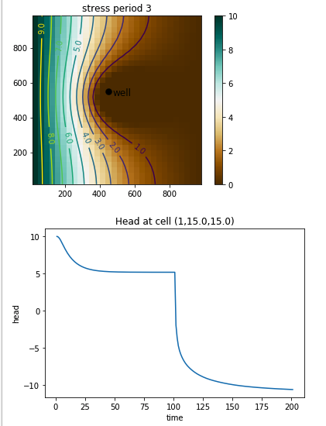
Steady State
So in order to run a pumping test you need to change to transient (non-steady) flow.
Over time the size of the cone of depression will expand
However, but with a constant pumping rate (and open boundaries that allow inflow of water) the model will evolve to reach a steady state.

Slide 10
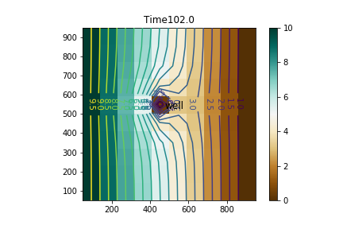
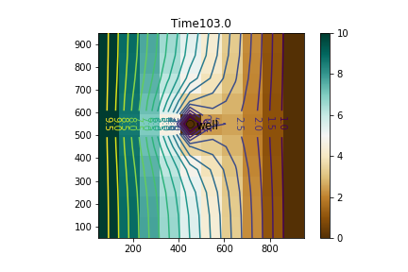
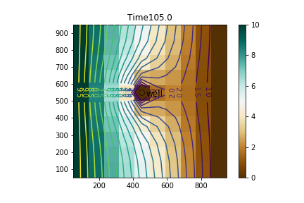
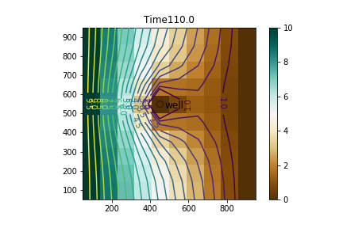

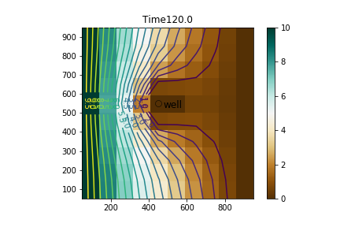
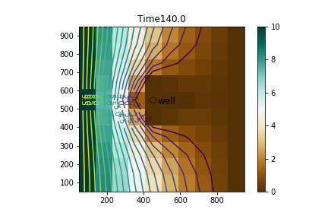
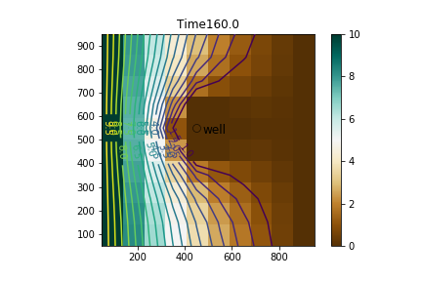
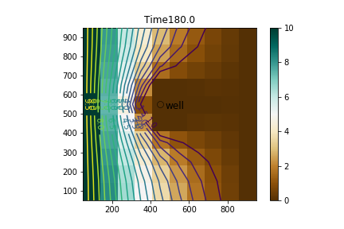
Expansion of the cone of depression during stress period 3.
Modifications to code to display this plot on next page.

Slide 11
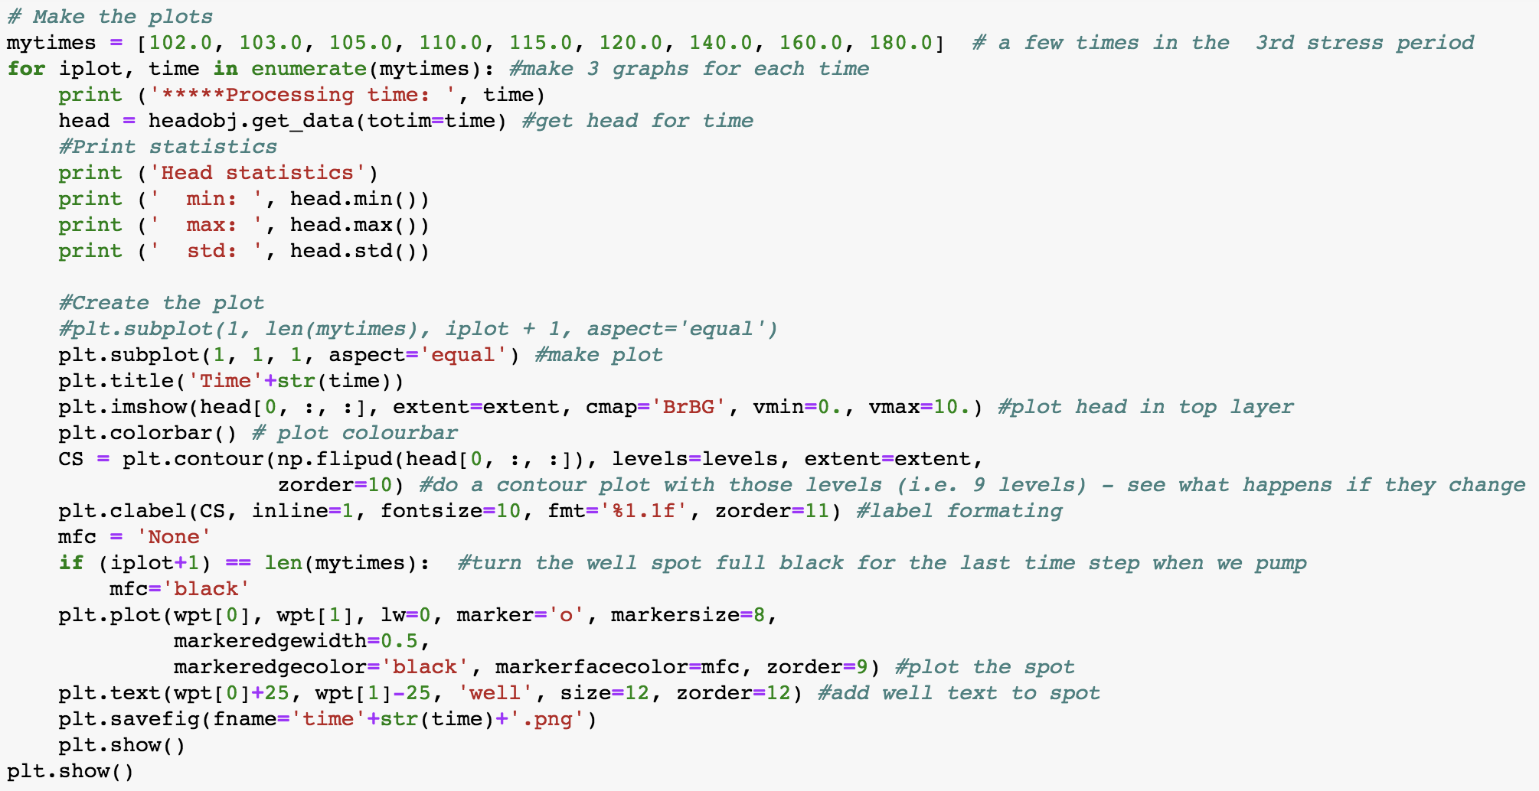

Slide 12
Injection Rate
We were slightly vague in simply telling you to‘vary pumping rate’
To be explicit you need to specify a negative injection rate if you are extracting groundwater.
This should have been clear if you had looked at the results:
extraction leads to development of a cone of depression around the pumping borehole, whilst injection leads to a recharge mound

Slide 13
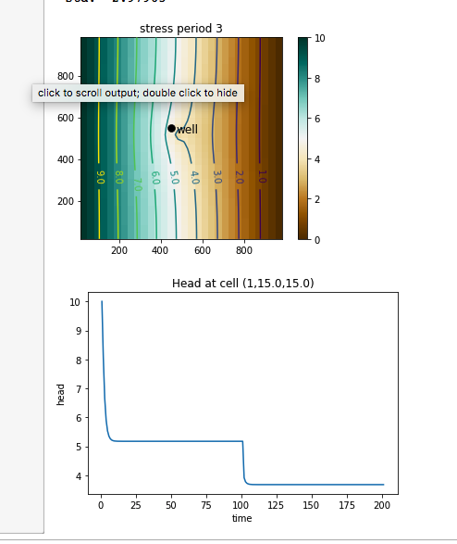
Sensitivity Analysis: Hydraulic Conductivity (K)
10 x lower Kv and Kh
Less permeable system – slower to reach steady state
Steady state drawdown is much greater for lower K – remember to look at ABSOLUTE values on y axis

Slide 14
Sensitivity Analysis: Hydraulic Conductivity (K)
10 x lower Kv and Kh
Less permeable system – slower to reach steady state
Steady state drawdown is much greater for lower K – remember to look at ABSOLUTE values on y axis
try to be consistent about the range displayed in graphs
here differing y-ranges make it hard to compare the two simulations

Slide 15
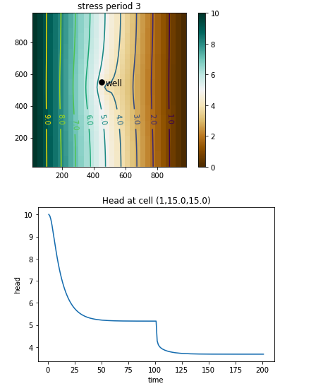
Ss affects time to reach steady state, but not head at steady state
Ss is water released by compression of aquifer/expansion of water
Volumes are small
Typical 10e⁻⁵ to 10e⁻³
Effects the response time, but not form of curve
Specific storage is more relevant for confined aquifers

Slide 16
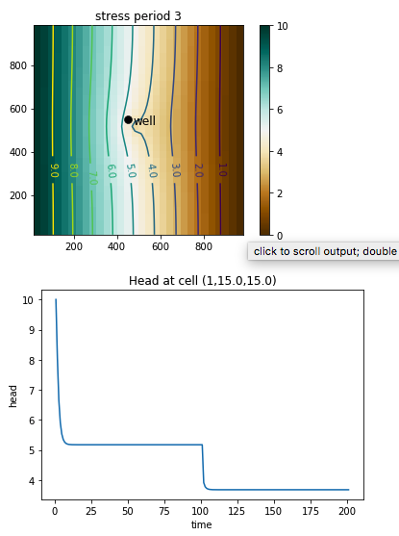
Varying Sy has no effect with these parameter values
Sy is water drained from within developing cone of depression
Important in unconfined aquifers
Sy cannot exceed porosity
Varies here 0.3 to 0.03
Minor (very minor!) difference to time to steady state (higher Sy gives slower development of cone of depression

Slide 17
General Lessons!
Formulate a hypothesis – what do you EXPECT to happen – from first principles – direction of change, nature of relationship (linear? Log-normal? Log-log?)
Research sensible range of parameter values to test eg if K varies over many orders of magnitude then test this range of values!
Run sensitivity tests – check results carefully (note scale changes on axes automatically to bracket results) and check BOTH response time and steady state condition
Compare results of sensitivity test to hypothesis
Be aware that parameters interact – changing one parameter may have little effect at low K but a large effect at high K

Slide 18
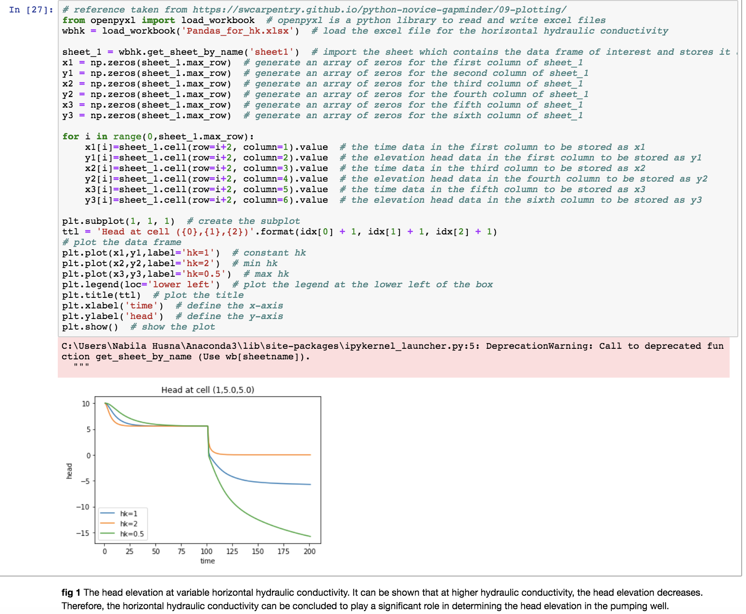
Displaying results of sensitivity analysis
This is lovely (but what units for hk?)
But even nicer if you extract new variables
time to steady state
head at steady state
Then you can plot these against values of hk….

Slide 19
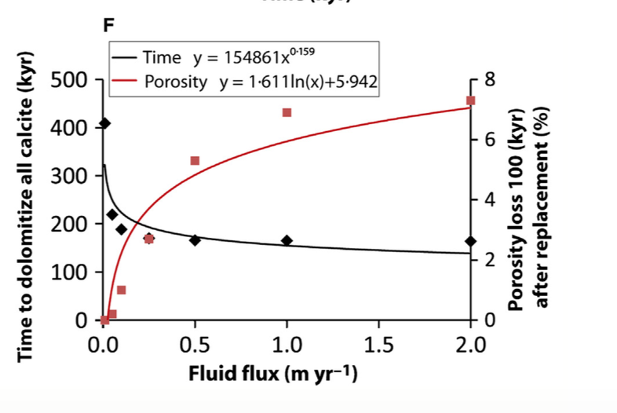

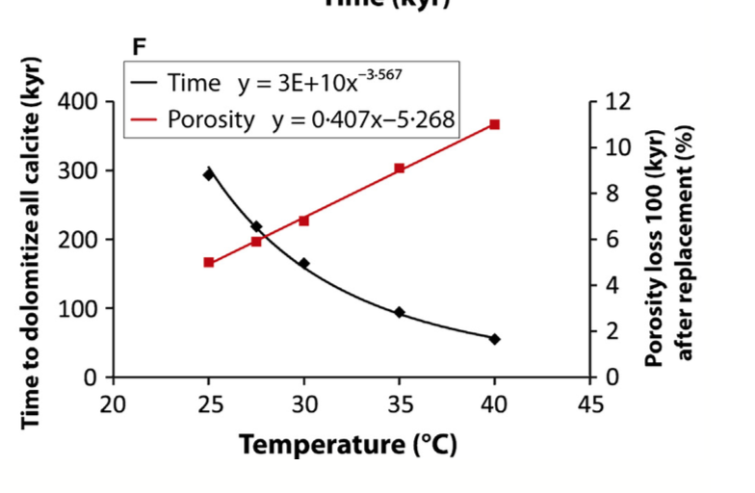
Example plots for sensitivity analysis

Slide 20
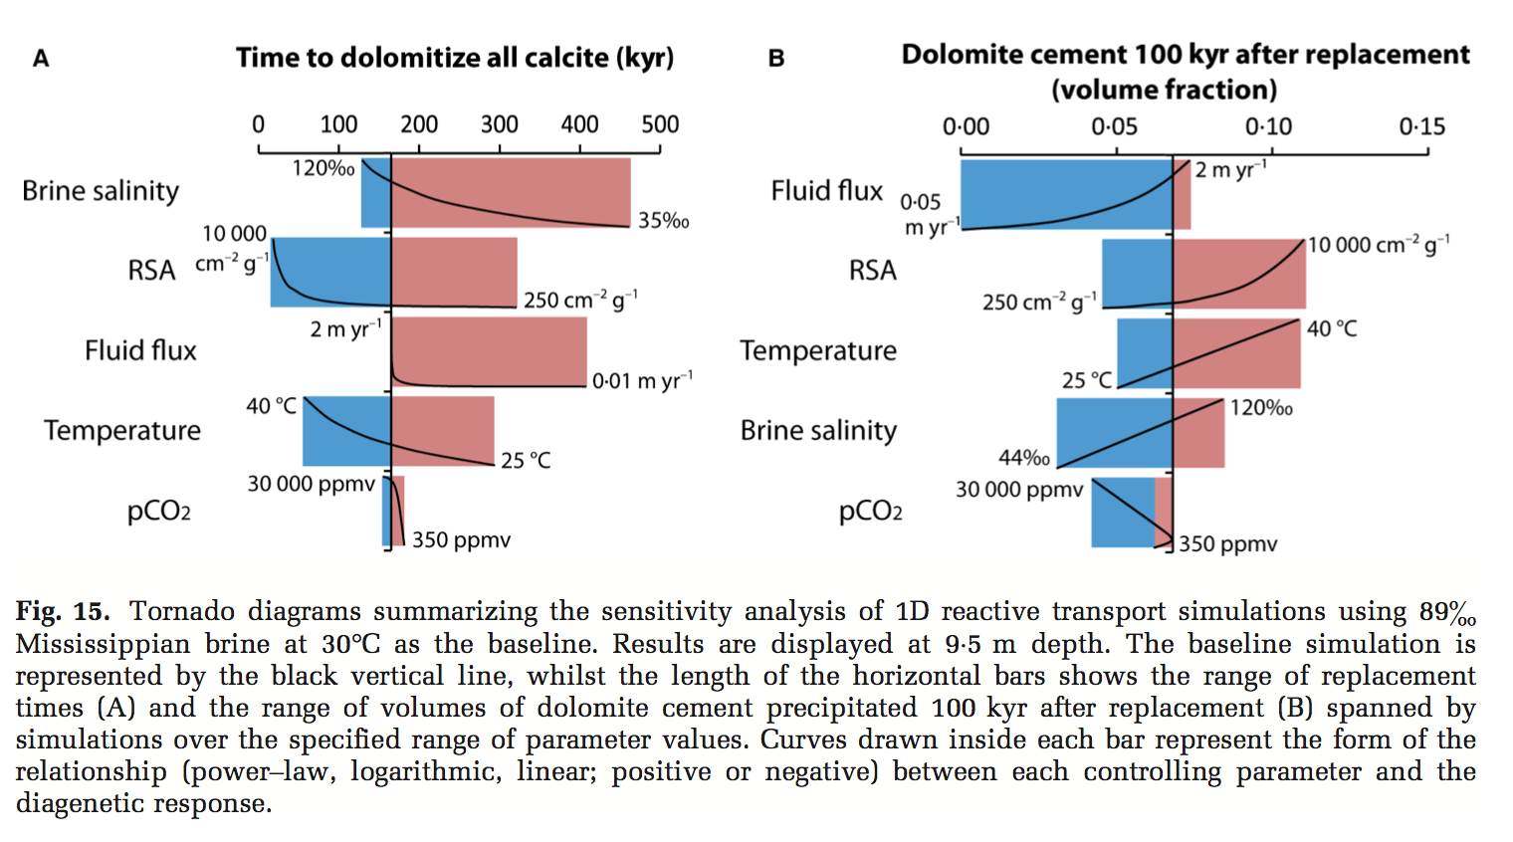
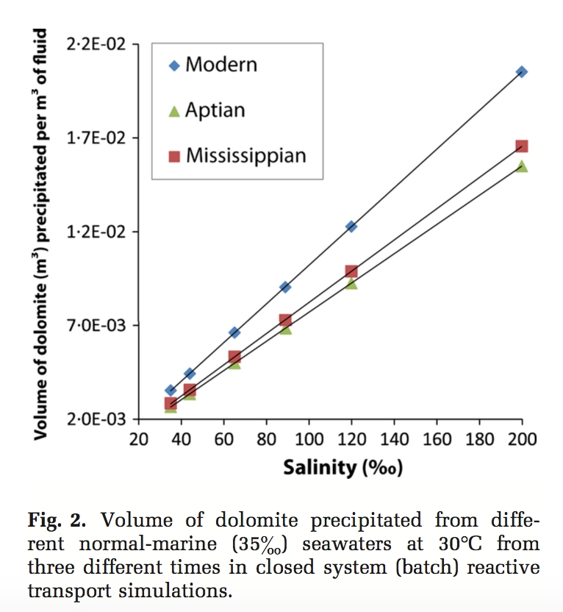
Example plots for sensitivity analysis

Slide 21
Some lovely coding!
There were some really ingenious solutions, such as saving results to external files and re-importing which meant you only had to run the script a few times.
We were particularly impressed by submissions that included images within the markdown of your notebook.

Slide 22
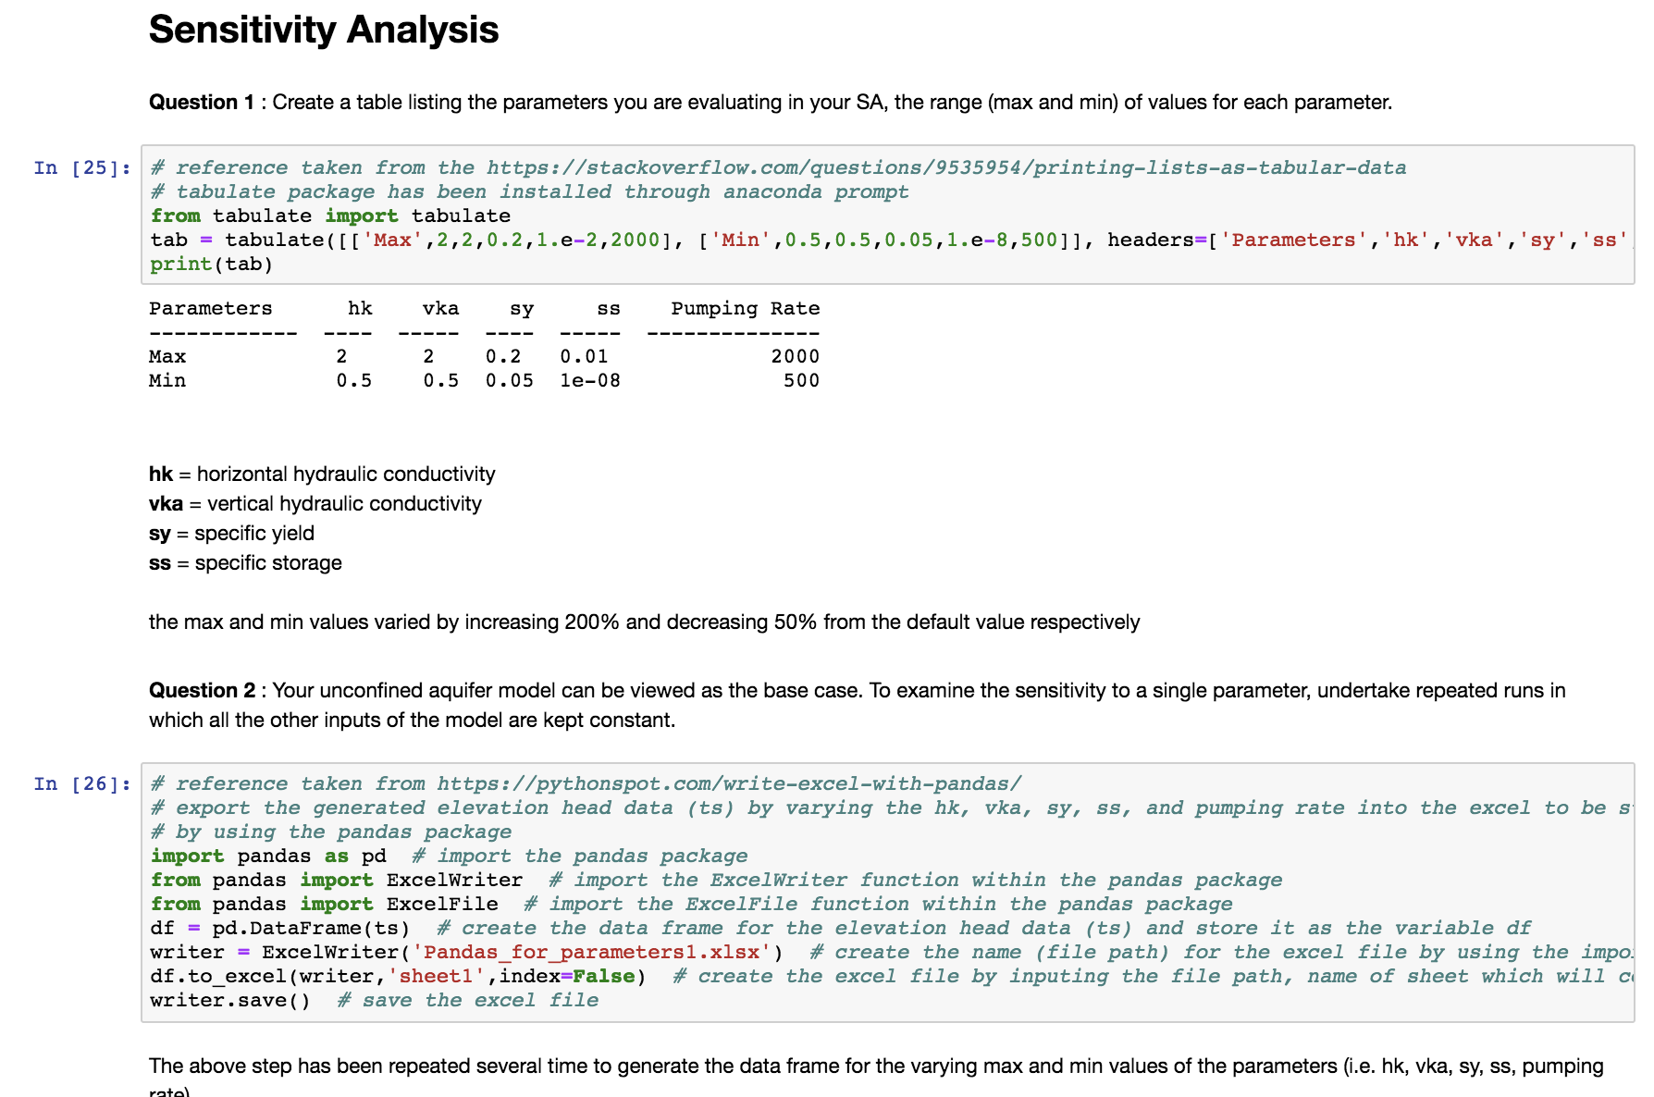
Most people chose to display the default table created using Pandas (recommended approach) but any methodology is acceptable, such as the package “tabulate”.
Original code from stack overflow is referenced in this case. 95% of beginner code is recycled stack overflow answers. Life becomes easier when you become more experienced with a module.
Does it make sense to vary all parameters over the same range?

Slide 23
Most people chose to display the default table created using Pandas (recommended approach) but any methodology is acceptable, such as the package “tabulate”.
Original code from stack overflow is referenced in this case. 95% of beginner code is recycled stack overflow answers. Life becomes easier when you become more experienced with a module.
Does it make sense to vary all parameters over the same range?
Here results of a single simulation are written to an external file using Pandas.
The user repeats this process, changing the output file name and sensitivity analysis conditions, until they have a collection of result files.
Writing to and reading from a csv file is much simpler than writing to Excel files and the recommended approach.

Slide 24
The result files are then imported back into the workbook.
Again the added complexity and hassle of using excel files is demonstrated by the substantial amount of additional code (red box) that could be eliminated using Pandas.
import pandas as pd
results_file = pd.readcsv(‘filename’,options)
results_file.plot(x,y,options)
Nevertheless the code is referenced, well-commented, complex, custom and was rewarded with high marks.

Slide 25
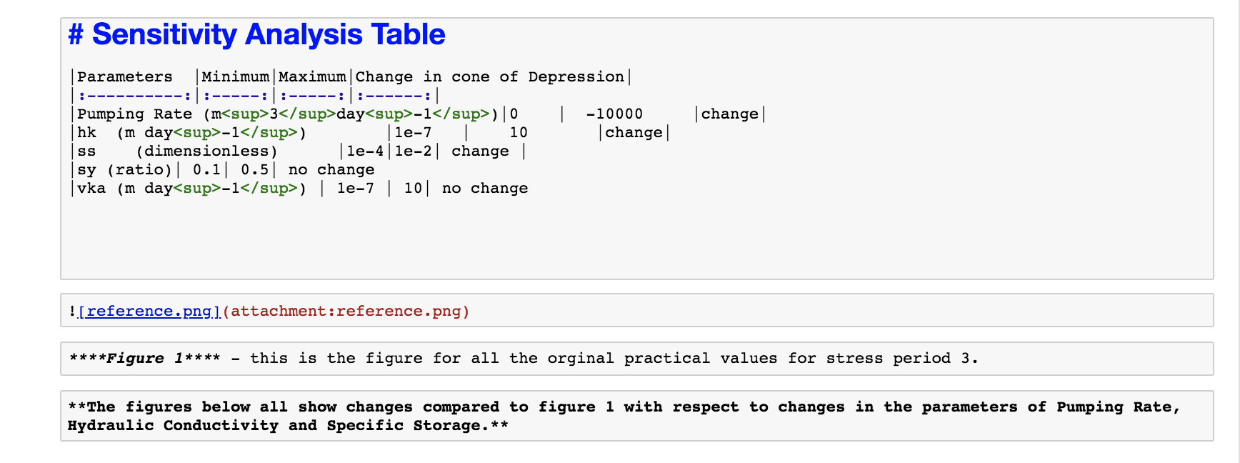
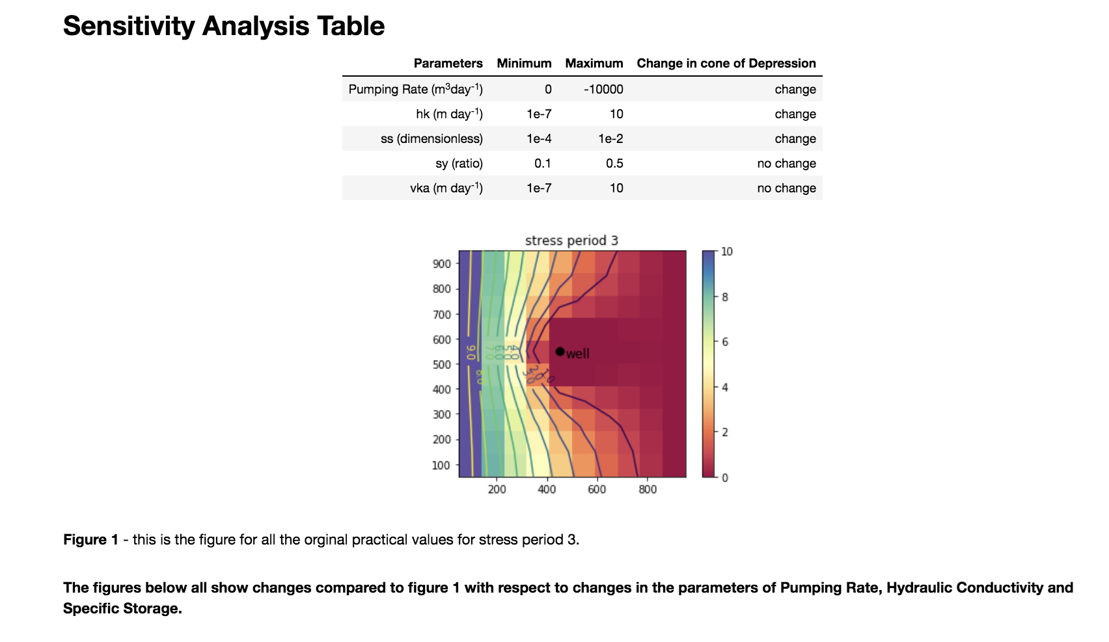
Example of how to include an image within markdown

Slide 26
Some live coding…..

Slide 27
Part A: Building a more realistic model Part B:P Part B: Opportunity for extension work
3D geometries
Layered system with confined and unconfined aquifers
Varying model resolution
Varying domain size
Particle tracking and timing
Considering pathways and fate of contaminants
Optional for bonus marks
Developing your expertise based on further work on an aspect of the model you select

Slide 28
Part A – Compulsory exercise
Building on the model you created during previous FloPy practicals simulating flow in a simple homogeneous aquifer,
You will model a layered aquifer, simulating the effect of pumping from a well pumping in the confined aquifer,
And use this model to a) calculate source protection zones around the pumping well and b) consider the potential contamination of the well following a release of pollutants from a point source in the catchment.
Note for some of these questions you will need to refer to material in forthcoming lectures on contaminant transport
Answers to questions in BLUE should be done as short comments to the code in the notebook, which will then be pushed to GitHub by 12.00 Monday 17th December.
Answers to questions in RED should be longer answers word processed in a separate document illustrated by screenshots. A hard copy of this should be handed to the School Office by 12.00 Monday 17th December, as well as being pushed to GitHub as part of your code
Marking criteria
Having a fully working code at the end of this exercise is the minimum you will require to score 50% in this assessment.
However, you also need to be able to demonstrate a hydrogeological understanding by fully answering the questions set.
Whilst it is possible to get a first-class mark without answering the bonus questions, these are potential extra marks available.
All students are required to undertake the work in Part A (as described below), and a complete answer to this can gain you marks up to 75%.
This part of the course will be supported by demonstrators present in practical sessions in weeks 8, 10 and 11.

Slide 29
Part A – Compulsory exercise
Building on the model you created during previous FloPy practicals simulating flow in a simple homogeneous aquifer,
You will model a layered aquifer, simulating the effect of pumping from a well pumping in the confined aquifer,
And use this model to a) calculate source protection zones around the pumping well and b) consider the potential contamination of the well following a release of pollutants from a point source in the catchment.
Note for some of these questions you will need to refer to material in forthcoming lectures on contaminant transport
Answers to questions in BLUE should be done as short comments to the code in the notebook, which will then be pushed to GitHub by 12.00 Monday 17th December.
Answers to questions in RED should be longer answers word processed in a separate document illustrated by screenshots. A hard copy of this should be handed to the School Office by 12.00 Monday 17th December, as well as being pushed to GitHub as part of your code
Marking criteria
Having a fully working code at the end of this exercise is the minimum you will require to score 50% in this assessment.
However, you also need to be able to demonstrate a hydrogeological understanding by fully answering the questions set.
Whilst it is possible to get a first-class mark without answering the bonus questions, these are potential extra marks available.
All students are required to undertake the work in Part A (as described below), and a complete answer to this can gain you marks up to 75%.
This part of the course will be supported by demonstrators present in practical sessions in weeks 8, 10 and 11.

Slide 30
Part A – Compulsory exercise
Building on the model you created during previous FloPy practicals simulating flow in a simple homogeneous aquifer,
You will model a layered aquifer, simulating the effect of pumping from a well pumping in the confined aquifer,
And use this model to a) calculate source protection zones around the pumping well and b) consider the potential contamination of the well following a release of pollutants from a point source in the catchment.
Note for some of these questions you will need to refer to material in forthcoming lectures on contaminant transport
Answers to questions in BLUE should be done as short comments to the code in the notebook, which will then be pushed to GitHub by 12.00 Wednesday 19th December.
Answers to questions in RED should be longer answers word processed in a separate document illustrated by screenshots. A hard copy of this should be handed to the School Office by 12.00 Wednesday 19th December, as well as being pushed to GitHub as part of your code
Marking criteria
Having a fully working code at the end of this exercise is the minimum you will require to score 50% in this assessment.
However, you also need to be able to demonstrate a hydrogeological understanding by fully answering the questions set.
Whilst it is possible to get a first-class mark without answering the bonus questions, these are potential extra marks available.
All students are required to undertake the work in Part A (as described below), and a complete answer to this can gain you marks up to 75%.
This part of the course will be supported by demonstrators present in practical sessions in weeks 8, 10 and 11.

Slide 31
Part B – for enthusiasts!
You have all done very well so far, and some have really excelled, at least at the coding elements.
We anticipate that the exercises in PART A should keep you occupied for two practical sessions.
We have not assigned extra work for the final session as for some the work set is challenging.
But to encourage you to consider accessing the very highest marks (80% and above) you have the opportunity to demonstrate independent thinking and effort, commensurate with a research level performance - Welcome to Part B!
This work is optional - There is no pressure to do this extra work! Consider it if you enjoy solving these kinds of problems or want to expand your understanding and experiences of FloPy/Python.
Read around what you can do to expand your model (new capabilities? A specific case study?)
If you are interested, then talk to me about your research ideas – we will try to manage things to avoid people working on similar mini-projects.
We will not support code development or bug fixing, but I will discuss your ideas and look at the output of codes to assist in interpretations.
Marking Criteria
To achieve a high first (>80%), and also be in with a chance to win the inaugural Excellence in Python-based Hydrological Modelling Prize awarded at the end of the year (complete with a small prize), you must not only show competency in the assigned work but develop it further.
Finished projects should be self-contained and will typically be openly shared online with the world. This is very much a research level experience!

Slide 32
Part B – for enthusiasts!
You have all done very well so far, and some have really excelled, at least at the coding elements.
We anticipate that the exercises in PART A should keep you occupied for two practical sessions.
We have not assigned extra work for the final session as for some the work set is challenging.
But to encourage you to consider accessing the very highest marks (80% and above) you have the opportunity to demonstrate independent thinking and effort, commensurate with a research level performance - Welcome to Part B!
This work is optional - There is no pressure to do this extra work! Consider it if you enjoy solving these kinds of problems or want to expand your understanding and experiences of FloPy/Python.
Read around what you can do to expand your model (new capabilities? A specific case study?)
If you are interested, then talk to me about your research ideas – we will try to manage things to avoid people working on similar mini-projects.
Finished projects should be self-contained and will typically be openly shared online with the world. This is very much a research level experience!
Marking Criteria
To achieve a high first (>80%), and also be in with a chance to win the inaugural Excellence in Python-based Hydrological Modelling Prize awarded at the end of the year (complete with a small prize), you must not only show competency in the assigned work but develop it further.
Finished projects should be self-contained and will typically be openly shared online with the world. This is very much a research level experience!

Slide 33
Part B – for enthusiasts!
You have all done very well so far, and some have really excelled, at least at the coding elements.
We anticipate that the exercises in PART A should keep you occupied for two practical sessions.
We have not assigned extra work for the final session as for some the work set is challenging.
But to encourage you to consider accessing the very highest marks (80% and above) you have the opportunity to demonstrate independent thinking and effort, commensurate with a research level performance - Welcome to Part B!
This work is optional - There is no pressure to do this extra work! Consider it if you enjoy solving these kinds of problems or want to expand your understanding and experiences of FloPy/Python.
Read around what you can do to expand your model (new capabilities? A specific case study?)
If you are interested, then talk to me about your research ideas – we will try to manage things to avoid people working on similar mini-projects.
Finished projects should be self-contained and will typically be openly shared online with the world. This is very much a research level experience!
Marking Criteria
To achieve a high first (>80%), and also be in with a chance to win the inaugural Excellence in Python-based Hydrological Modelling Prize awarded at the end of the year (complete with a small prize), you must not only show competency in the assigned work but develop it further.
We will not support code development or bug fixing, but I will discuss your ideas and look at the output of codes to assist in interpretations.

